Slide 1
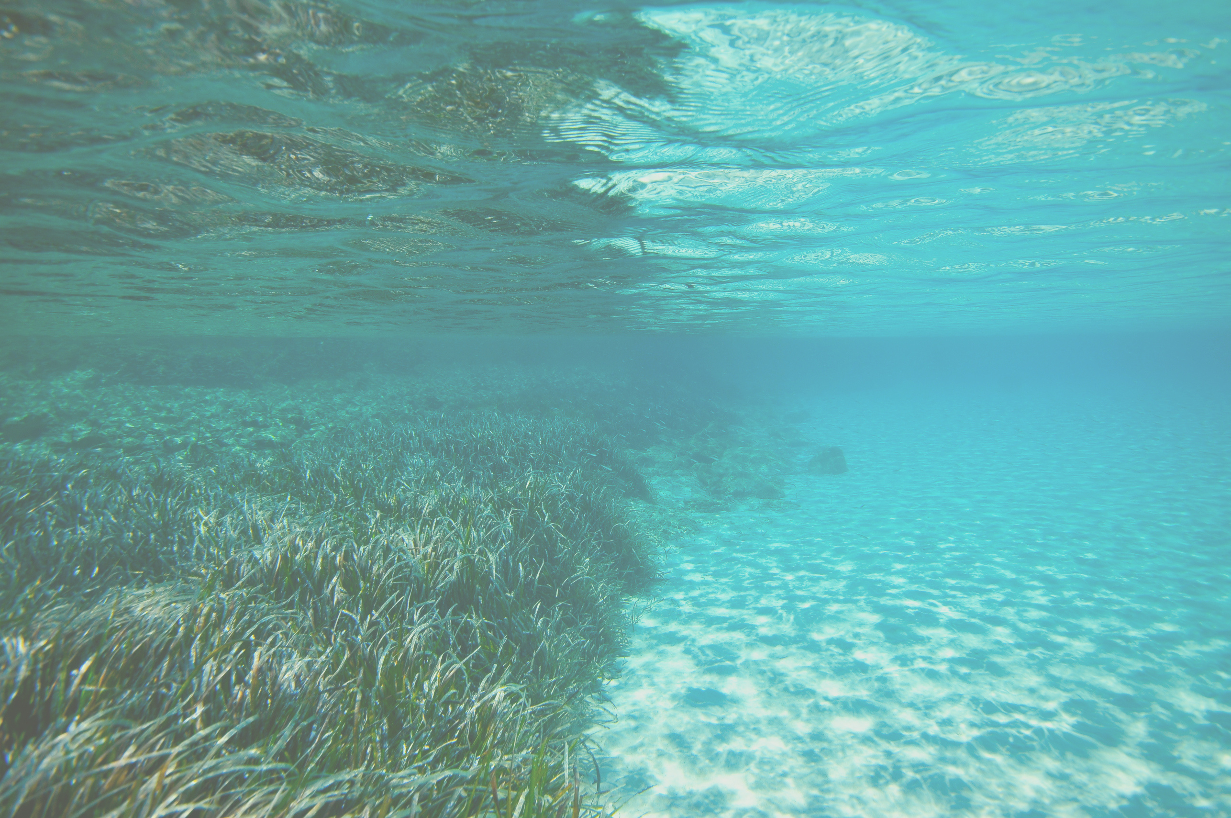


AGU 2025
Hydrodynamics and Seagrass Growth: Evaluating Wave Climates and Sediment Transport
Namritha Ramakrishnan¹, Manisha Thenuwara¹, Peter Vien¹, Iacopo Vona¹,
Laura Andrade-Barron¹, Kelly M. Kibler^{1,2}
¹Department of Civil, Environmental, & Construction Engineering, University of Central Florida
²National Center for Integrated Coastal Research, University of Central Florida
Notes:
Good afternoon, everyone. My name is Namritha Ramakrishnan, and I am a master’s student at the University of Central Florida.
Today, I will be presenting preliminary results of my ongoing thesis research focusing on the critical ecological agent: seagrass.

Slide 2
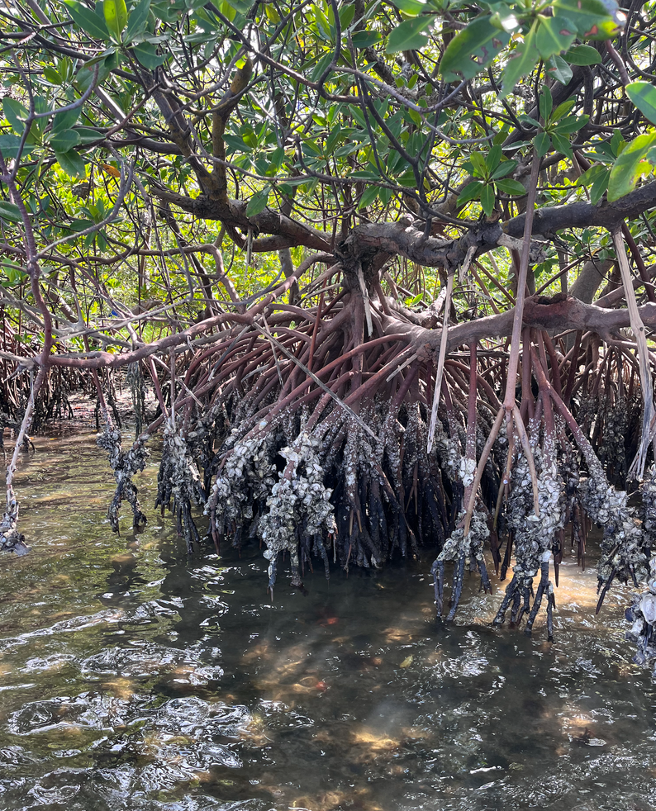
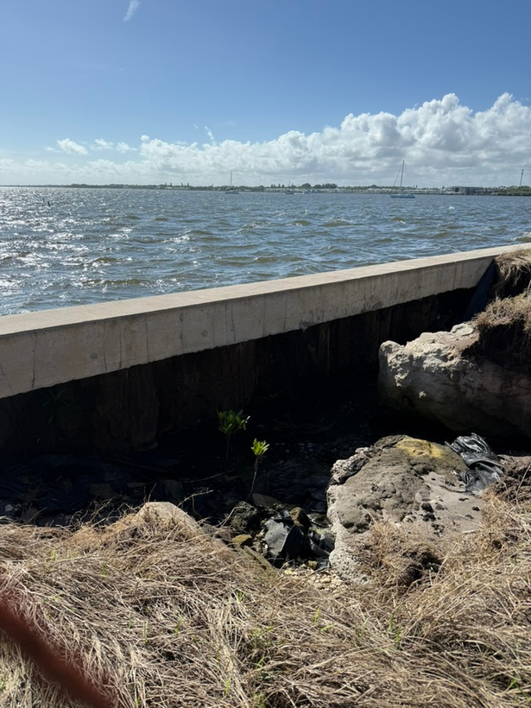
Climate Threats and the Need for Coastal Resilience
Sea level rise is accelerating - primary driver increasing coastal risk (flooding, erosion) worldwide (Oppenheimer et al., 2019)
Marshes, mangroves, and seagrasses offer “natural defense” (Temmerman et al., 2013)
Traditional hard defenses are rigid - NBS and NNBF provide resilient and adaptive alternatives (Borsje et al., 2011)
Intro
Notes:
We are facing an accelerating crisis defined by climate-driven risks:
Sea-level rise.
Increasing intensity of storm-driven wave energy and storm surge.
Traditional “gray” infrastructure (seawalls, jetties) is rigid and cannot adapt or grow with sea level rise. We need adaptive, resilient solutions.
Natural and Nature-Based Features (NNBF) like seagrass and mangroves offer a paradigm shift.
They are living systems that restore ecological function while providing coastal protection by dissipating wave energy.

Slide 3
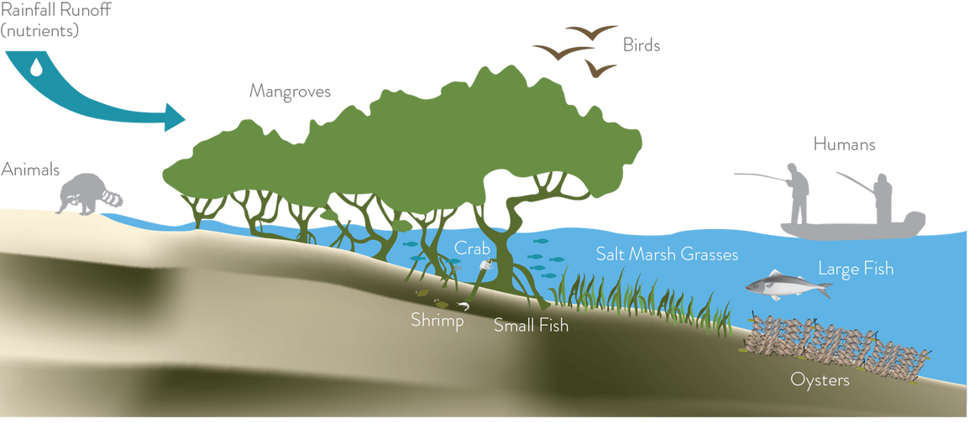
Anthropogenic Stressor: Degrading Natural Buffers
Seagrass meadows are in rapid global decline, with documented losses reaching up to 17% since the 1990s (Waycott et al., 2009)
Human development introduces massive excess nutrients into coastal waters through runoff, causing eutrophication (Bowen & Valiela, 2001)
Eutrophication fuels rapid growth of algal blooms, reducing light available for seagrass to grow (Dennison et al., 1993)
Intro
Notes:
The resilience provided by these natural features is being systematically degraded by intense human development in coastal watersheds.
This development causes excess nutrient inputs (Nitrogen, Phosphorus) from sources like fertilizers and wastewater.
Nutrient enrichment fuels Harmful Algal Blooms (HABs), creating high turbidity and blocking the sunlight essential for seagrass survival. This directly impacts seagrass's water quality dependency.
Human development also physically alters local hydrodynamics:
Constructing causeways restricts flushing.
This traps pollutants and warm water, exacerbating eutrophication.
In short: Human activity is simultaneously creating the threat and destroying the solution (seagrass meadows).

Slide 4
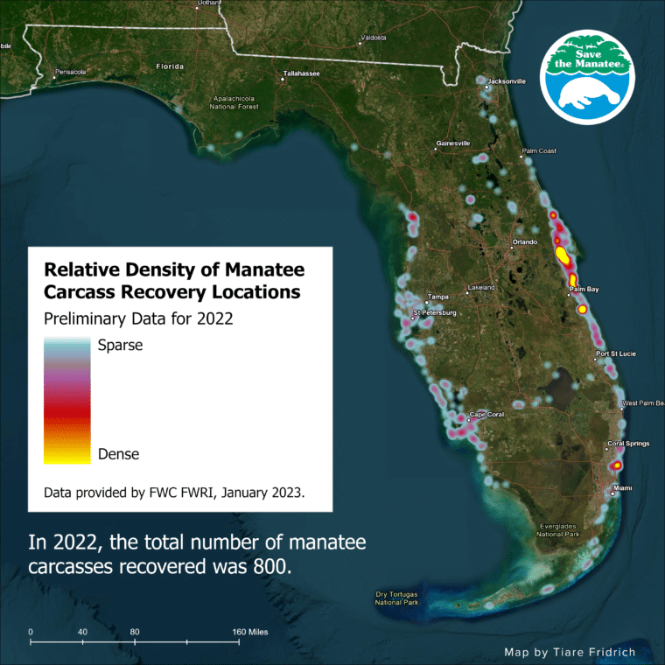
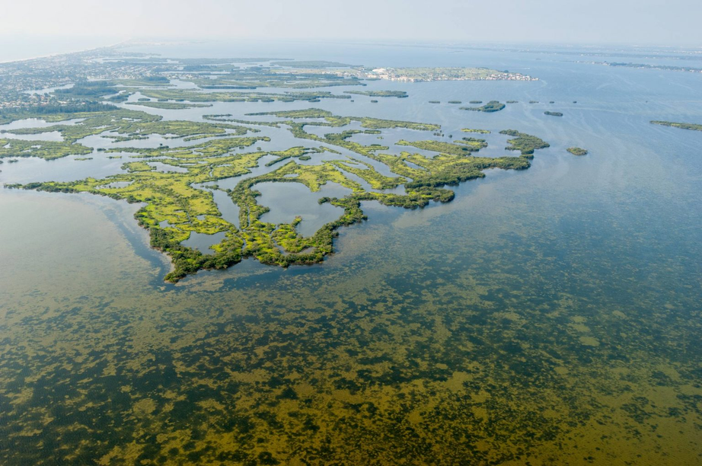
IRL Case Study: The Cost of Eutrophication
Chronic nutrient loading and altered hydrodynamics created conditions for severe harmful algal blooms (HABs) (IRL NEP Annual Report, 2021)
Since 2011, IRL has lost an estimated 58% of its seagrass area (Morris et al., 2021)
Record-breaking manatee unusual mortality event starting late 2020 (FWC, 2022)
Intro
Notes:
The Indian River Lagoon (IRL) is the epicenter of this problem.
Chronic eutrophication and "Super Blooms" (like the intense 2019-2020 cyanobacterium bloom) led to massive die-offs of seagrass.
Between 2011 and 2019, approximately 58% (~19,000 ha) of the IRL’s seagrass was lost—a functional collapse.
The loss of seagrass, the primary food source, directly led to the record-breaking Manatee Unusual Mortality Event (UME) starting in 2020-2021.
This local crisis highlights the urgent need to understand and utilize the protective function of seagrass as a robust NNBF.

Slide 5
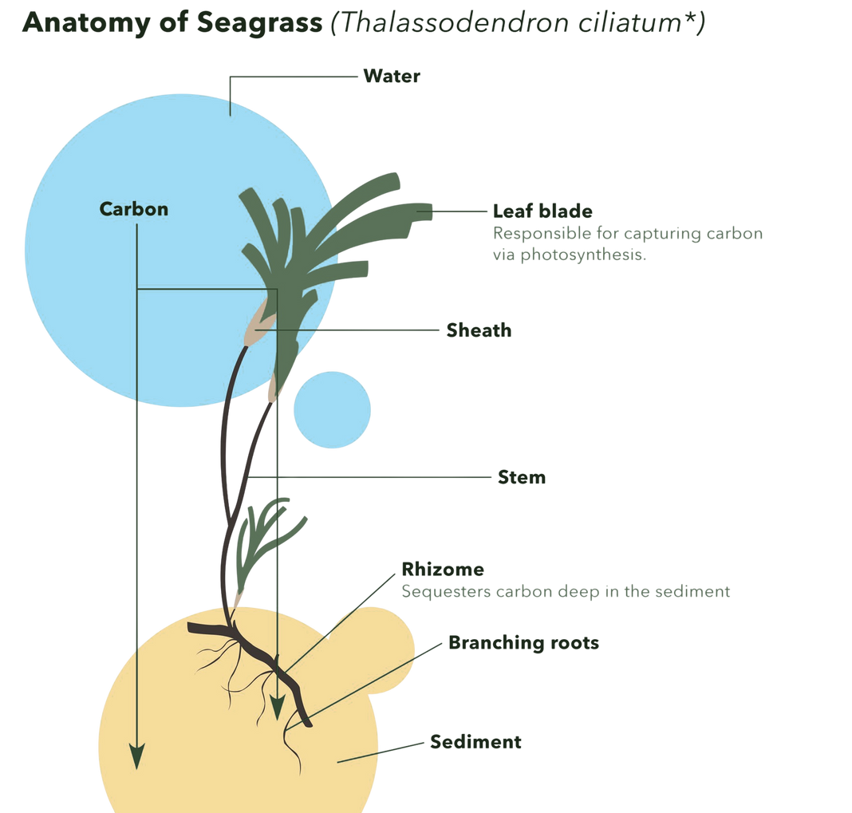
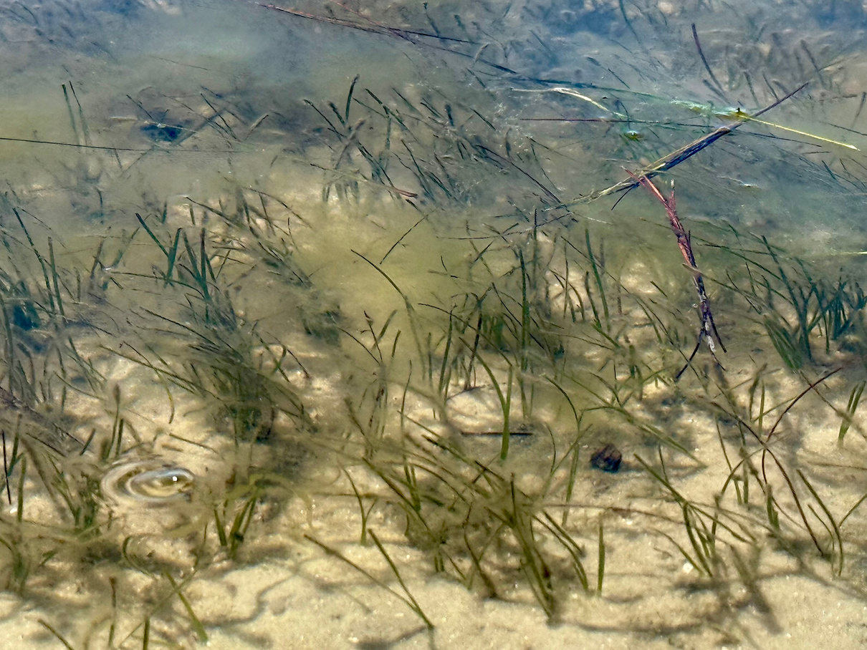
Seagrass: The Ecosystem Engineer
Seagrass is a critical benthic habitat (nursery, food).
Ecosystem: Engineers
Blades/canopy: Above-ground friction to dampen wave energy
Rhizome/root mat: Below-ground stabilization to trap and bind sediment
Post bloom recovery strongest where rhizome was intact (Morris et al., 2021)
Association for Coastal Ecosystem Services, 2024
Intro
Notes:
Seagrasses are Submerged Aquatic Vegetation (SAV) that are true Ecosystem Engineers—they actively modify the environment by stabilizing sediments and dampening waves.
The seagrass plant has two key components influencing coastal dynamics:
Above-Ground (Blades/Canopy): The dense, flexible blades increase drag and friction in the water column.
Below-Ground (Rhizome/Root Mat): The dense root structure binds and stabilizes the sediment.
Limited recovery after the 2019-2020 bloom was observed most robustly where the below-ground root mat remained partially intact.
This reinforces the importance of these intact structural elements for the system to recover and withstand future shocks.
Understanding how these structural elements interact with waves and currents is essential for developing predictive models for future Nature-Based Solutions.

Slide 6

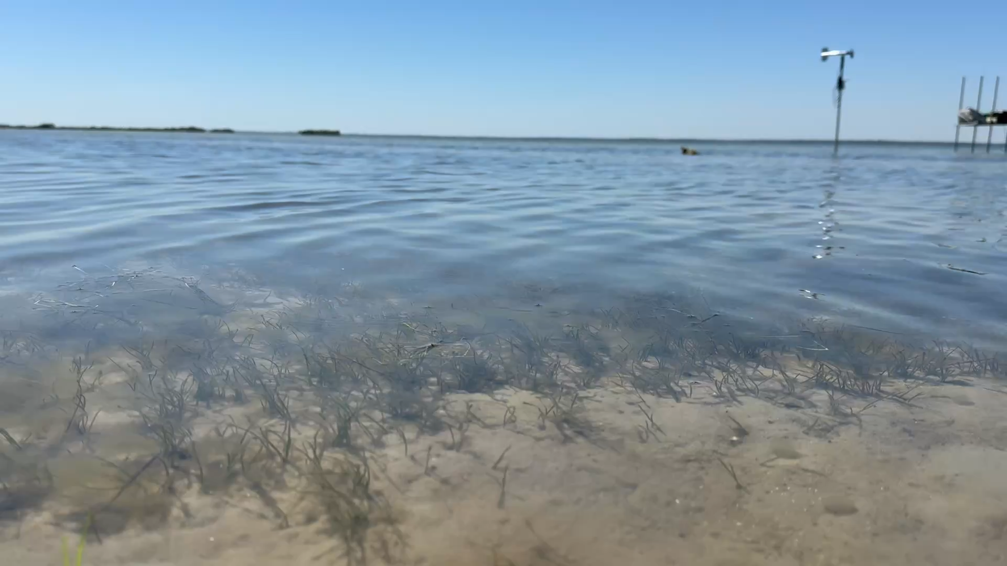
Research Focus
Hydrodynamics: Quantify wave characteristics and energy attenuation within seagrass
Sediment transport: Compare suspended sediment concentration (SSC) between vegetated and bare sites
Synthesis: Link the seagrass density to functional outcomes
Intro
Notes:
Our research transitions from the crisis to the mechanics: How does a natural seagrass meadow function as an engineering solution?
We conducted rigorous field work to quantify these dynamics directly:
Objective One (Coastal Protection): Quantify the reduction in wave characteristics as waves travel through the meadow.
Objective Two (Sediment Transport): Evaluate the ability of the meadow to stabilize the seabed by quantifying reduction in suspended sediment concentration (SSC).
Objective Three (Synthesis): Link the measured seagrass density to resulting functional outcomes (wave attenuation and SSC reduction).
Our findings provide the fundamental design criteria needed to replicate these natural dynamics in future Nature-Based Solutions (NBS), ensuring their effectiveness and resilience.

Slide 7
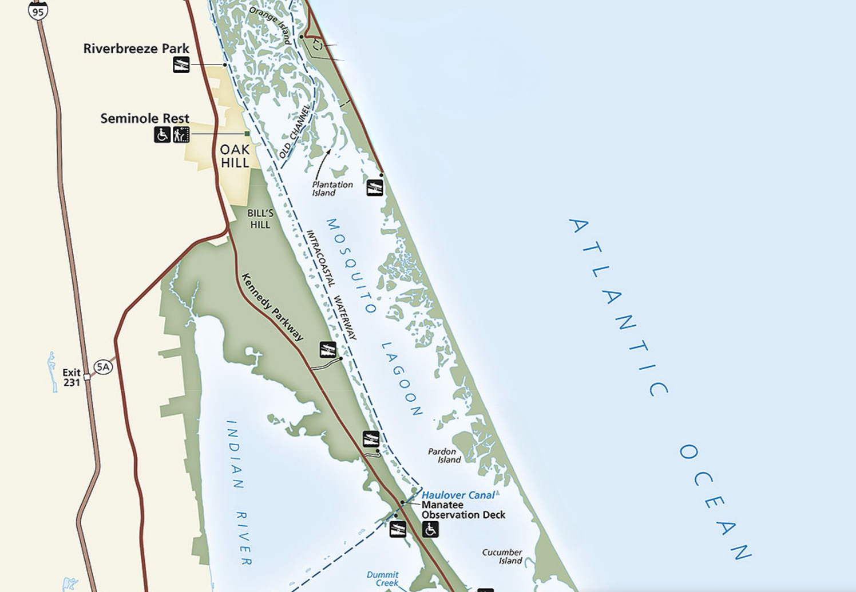
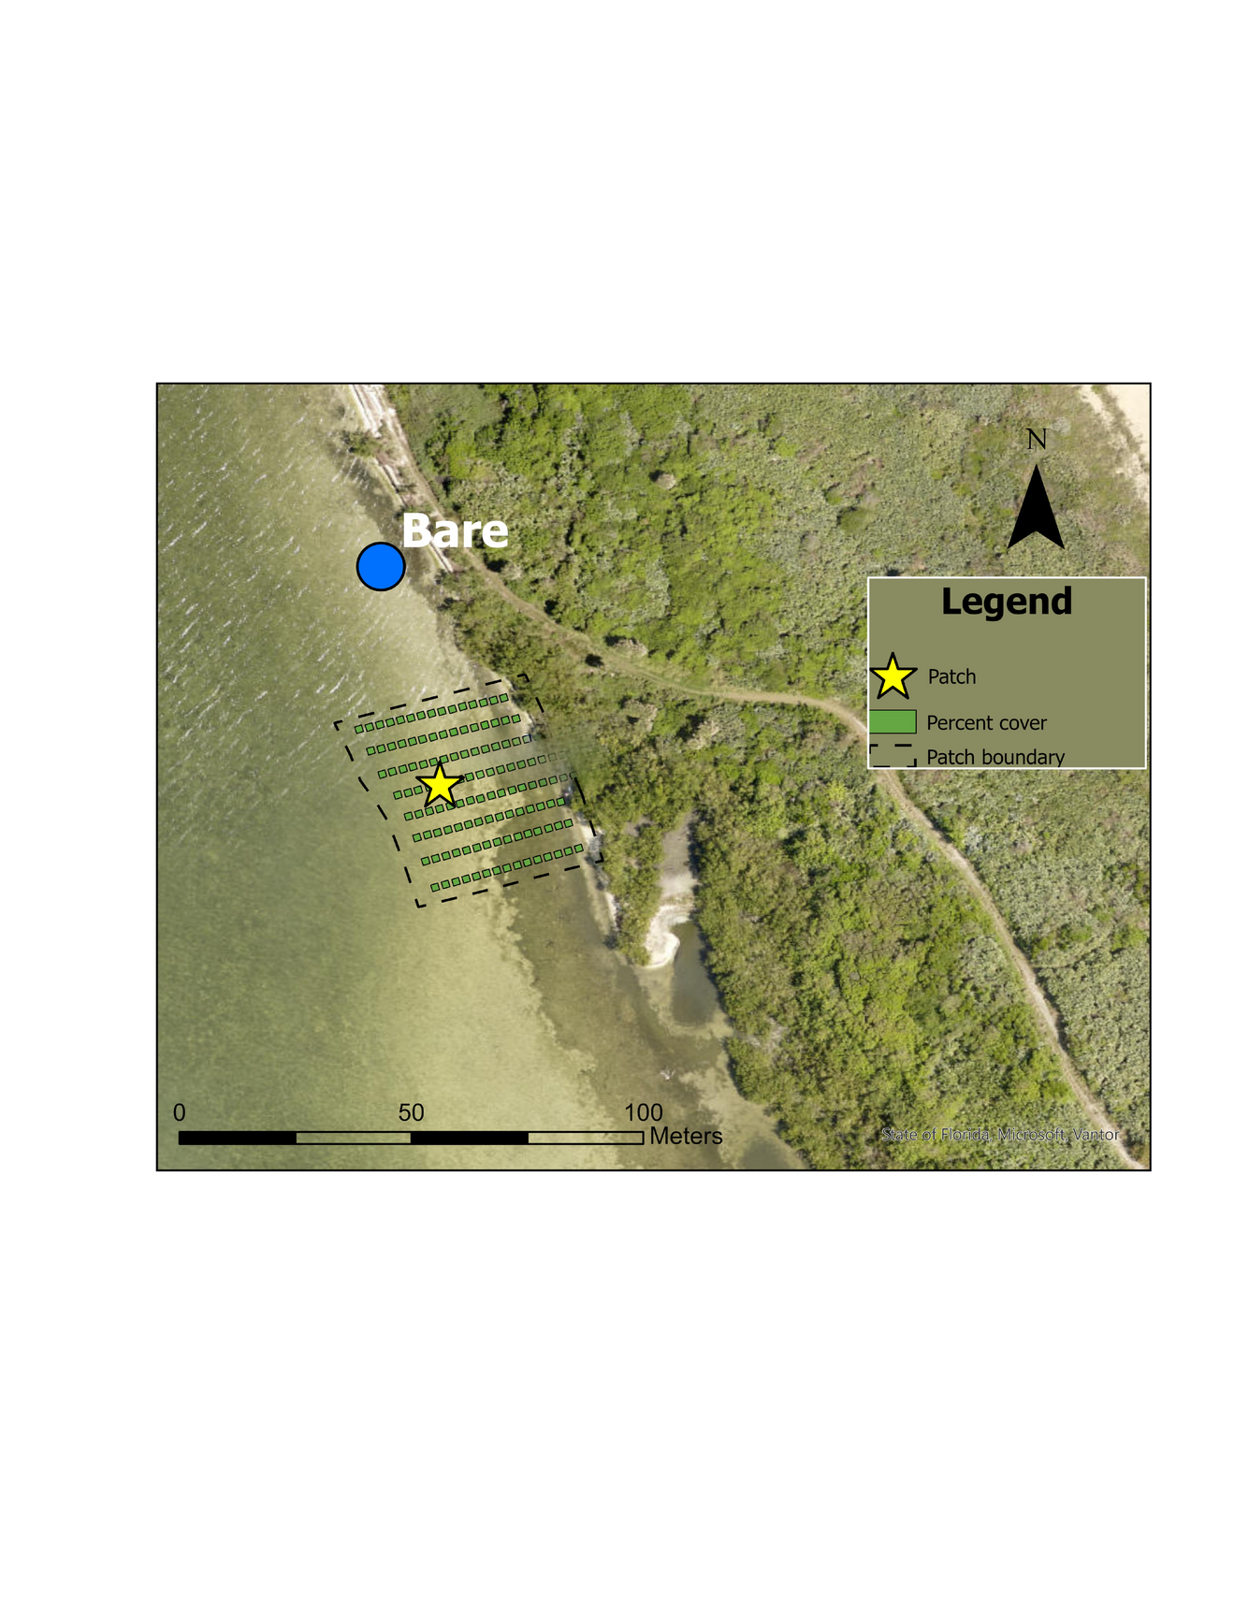

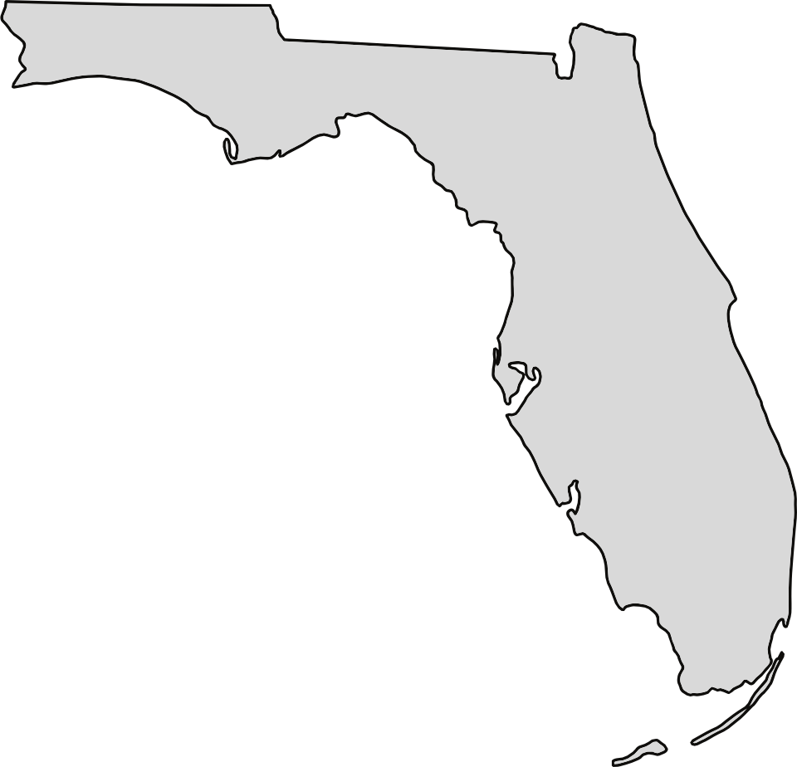

Study Site
Location: Mosquito Lagoon, FL (part of the IRL)
Setup: Paired sensor deployments in vegetated and bare areas
Depth constant
Local hydrodynamics: low-energy, fetch limited wind waves
H80 Bare = 6 cm
Tavg Bare = 1.2 s
Bare
Vegetated
Vegetated
Methods
Notes:
Our study was conducted in Mosquito Lagoon, part of the Indian River Lagoon system.
We utilized a controlled, paired-plot experimental design: deployed sensors simultaneously in a healthy, dense Vegetated Patch of Halodule wrightii and an adjacent Bare Site.
This setup precisely isolates the structural effect of the seagrass, controlling for factors like water depth.
The lagoon is a low-energy, fetch-limited wind-wave environment.
Reference forcing at the bare site: H80 ~ 7 cm and T_{avg} ~ 1.2 s. This is the energy constantly entering the system.
Reference forcing remained consistent throughout the study. This consistency ensures that any measured attenuation is a direct result of the seagrass structure.

Slide 8
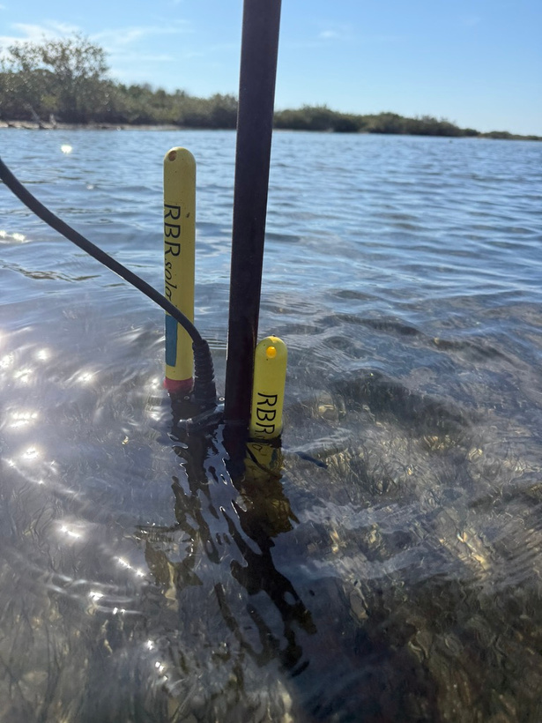
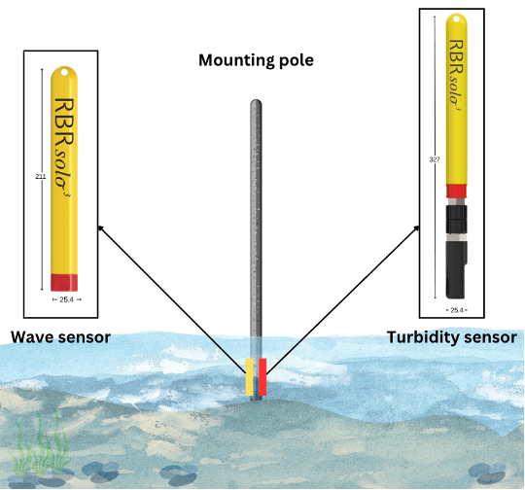
Data Collection
Wave data - pressure sensors
Turbidity data - Seapoint turbidity sensor
equipped with anti-fouling wipers
Regular field cleaning to ensure data quality
Collection period: Continuous data collected over a full canopy growth season (April - present)
Sparse → dense
Methods
Notes:
We deployed a suite of high-frequency instruments:
Hydrodynamics (Objective One): RBR solo³ Dwave 16 Pressure Sensors captured incoming wave height and energy.
Sediment Dynamics (Objective Two): RBR solo³ Seapoint Turbidity Sensors measured Turbidity. Anti-fouling wipers and regular cleaning ensured the integrity of the long-term data set.
Physical data was paired with biological data: we conducted three structural quantifications of the Halodule wrightii meadow (percent cover, shoot length).
The key: We gathered continuous data over a full canopy growth season. This allowed us to naturally capture the transition from the meadow's initial sparse growth phase to its peak mature/dense canopy, which is necessary to isolate the density-dependent functional outcomes.

Slide 9
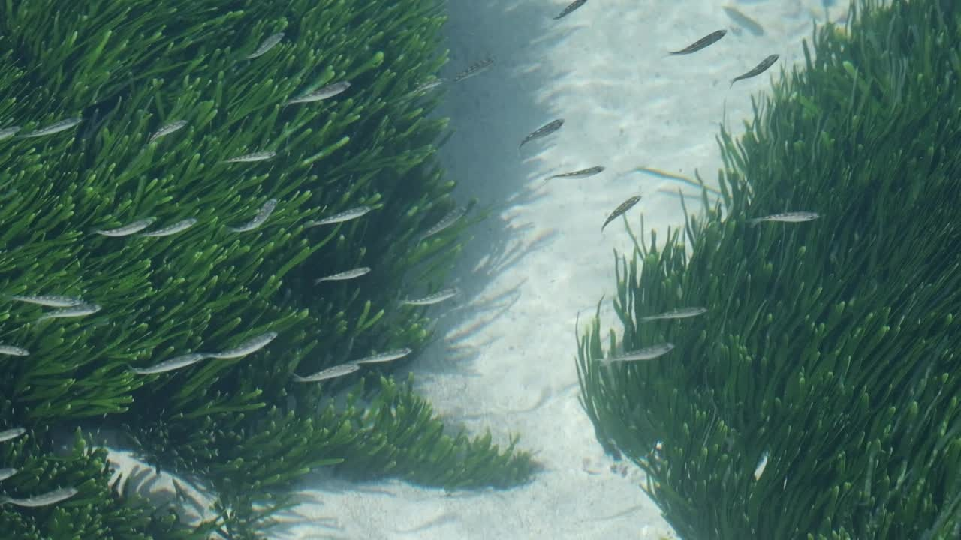

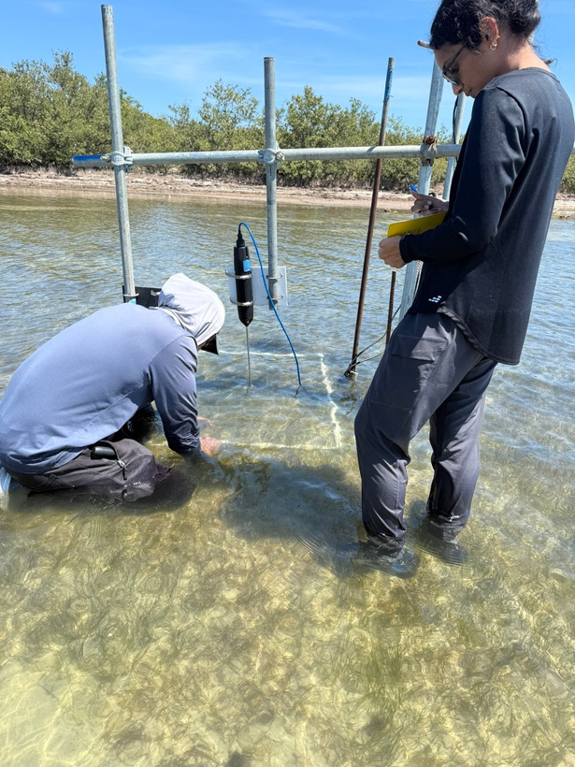
Percent Cover Survey
Modified percent cover method (Morris et al., 2000)
1 m2 quadrat divided into 100 cells (10 x 10 cm)
Density estimated between 0 & 1 for each cell
Repeated throughout seasonal growth pattern
April, July, September
Provides structural data to link density to functional outcomes
1 2 3 4 5 6 7 8 9 10
10 9 8 7 6 5 4 3 2 1
Quadrant data collection visual
(video credit: blackbox1)
Methods
Notes:
To quantify the canopy structure, we used a percent cover survey adapted from Morris et al.
We utilized a 1-square-meter quadrat subdivided into 100 cells, scoring each cell from 0 to 1, deriving a high-resolution density value.
Surveys covered the full patch extent along 8 distinct transects.
We repeated these surveys throughout the study, documenting the meadow's growth from April through September to capture the seasonal density transition necessary to link structure to function.

Slide 10
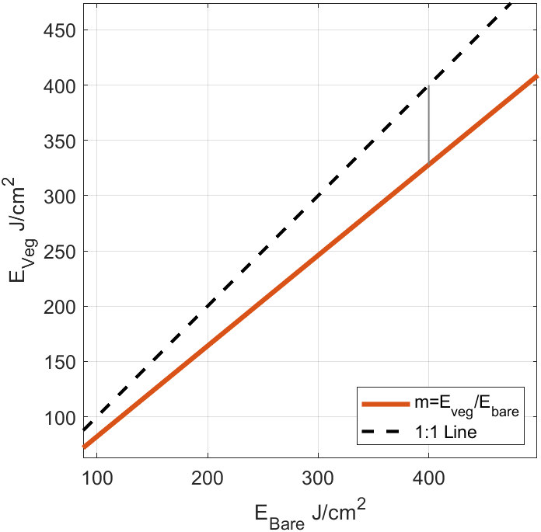
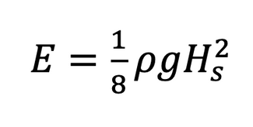
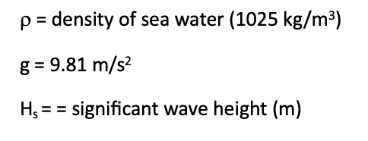
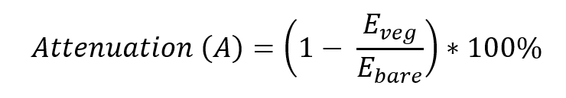
Data Analysis - Wave
Raw pressure data is converted by Ruskin (RBR software) to wave parameters using spectral analysis
Wave energy attenuation (A) was calculated as the deviation of the slope of the least squares regression line from the 1:1 line
Methods
Notes:
First, we converted raw pressure readings into wave parameters (H_{s}) using spectral analysis.
We calculated Wave Energy (E) for each site using linear wave theory: E = 1/8*rho*g*H_{s}²
To quantify Wave Energy Attenuation (A), we examined the simultaneous energy measured at both sites.
Attenuation is defined as the deviation of the slope of the least squares regression line from the 1:1 unity line (which represents zero attenuation).
The slope of our actual data gives the ratio of energy transmitted, and therefore, one minus the slope gives us the percentage of energy attenuated by the seagrass structure.

Slide 11
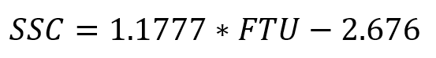
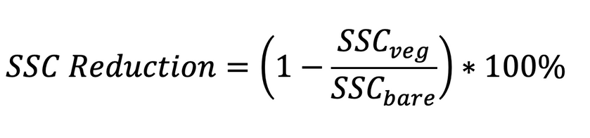
Data Analysis - SSC
Collected raw turbidity data (NTU):
Quality controlled
Converted to SSC (mg/L) using a site-specific calibration curve
Quantify difference between bare and vegetated sites
Separate data into sparse and dense canopy periods
Methods
Notes:
Raw output from the RBR Turbidity sensors is in FTU.
Essential first step: Convert this raw data into Suspended Sediment Concentration (SSC), measured in {mg/L}, using a field-derived calibration curve.
We quantified sediment reduction by calculating the percentage reduction in SSC compared to our Bare Site reference.
Finally, this SSC reduction data will be analyzed by segregating the functional outcomes into the defined Sparse and Dense canopy periods.
This will allow us to test if the meadow's SSC reduction capacity is, in fact, highly dependent on its structural density.

Slide 12
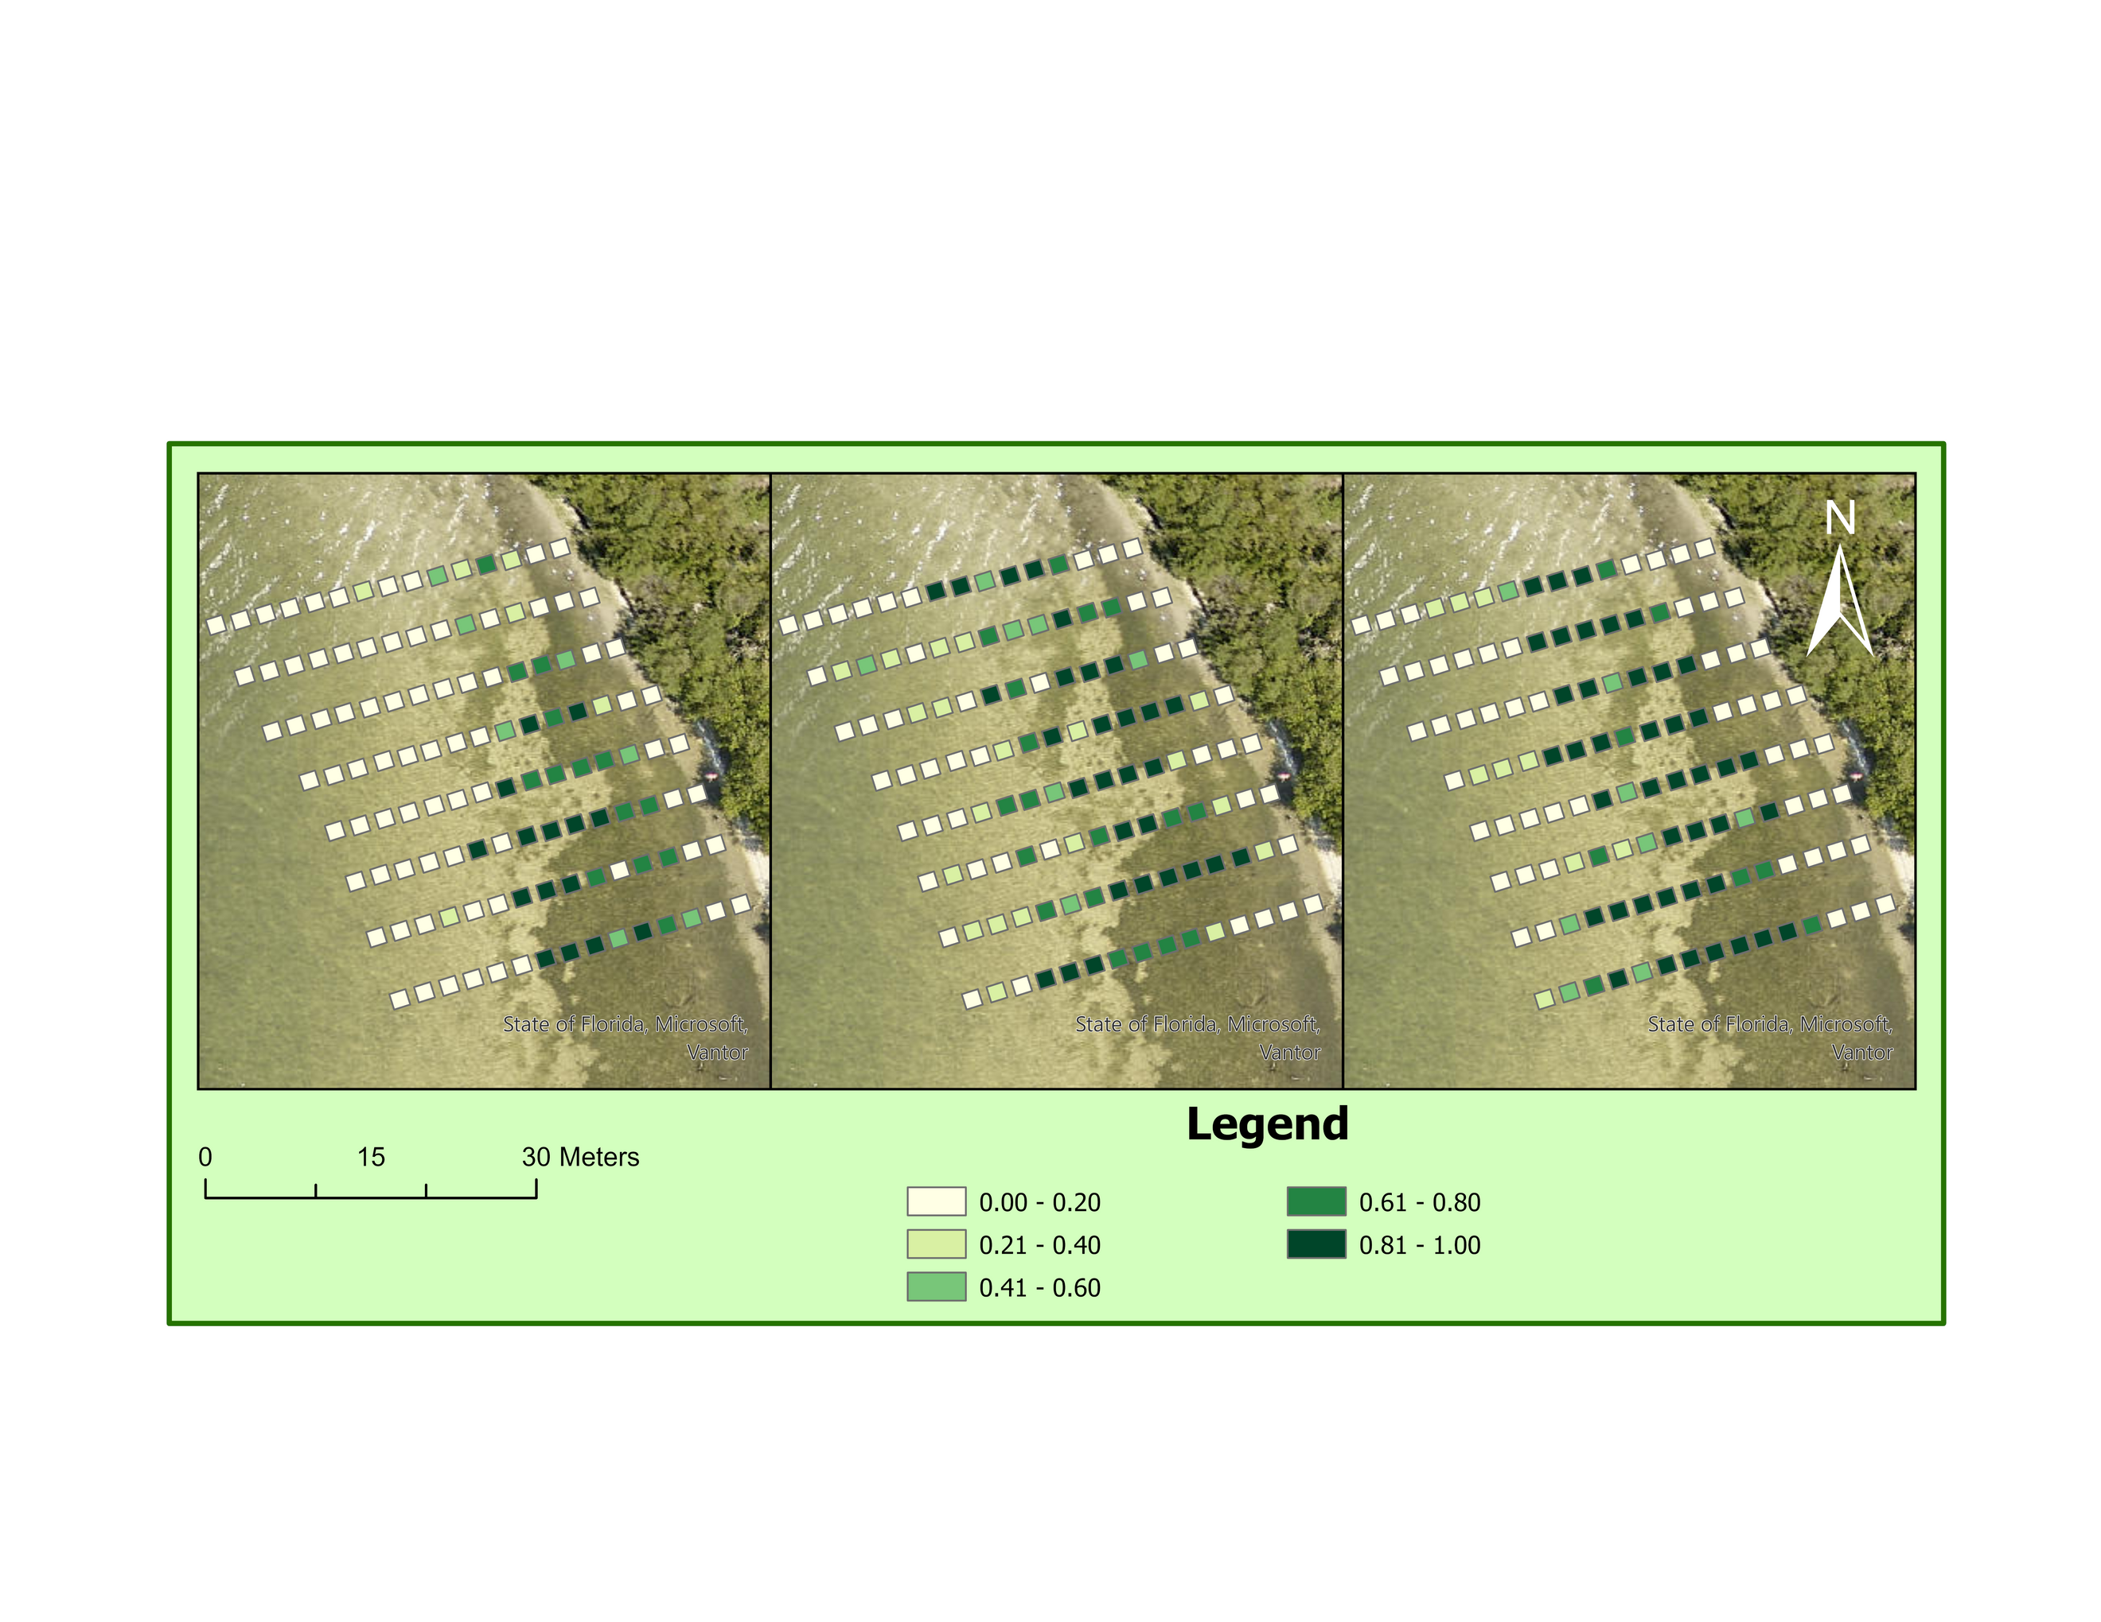
Defining the Meadow Over Time
Vegetated site is not a static system; density increased over time
Variability allows correlation with density and attenuation
April - Sparse
32% total
40% near sensor
July - Dense
41% total
76% near sensor
September - Dense
48% total
80% near sensor
April
July
September
Results
Notes:
This map shows the foundational structural change (percent cover) during our study. The canopy structure provided a clear gradient for our analysis.
Phase 1 (Sparse Canopy - April):
Average patch cover: 32%.
Cover at the hydrodynamic sensors: 40%.
Phase 2 (Denser Canopy - July):
Average patch cover increased to 41%.
Cover at the sensors saw a significant jump, reaching 76%.
The sensor cover jumped from 40% to 76%. This significant change in density is the independent variable.
It justifies our decision to segment all subsequent hydrodynamic and sediment data into Phase 1 (Sparse) versus Phase 2 (Denser), directly testing if functional performance is dependent on structural density.

Slide 13
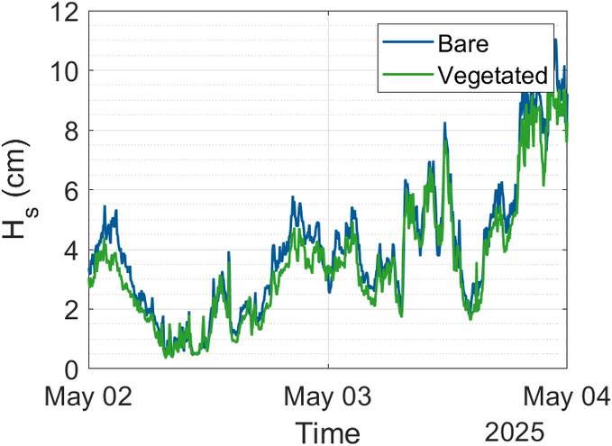
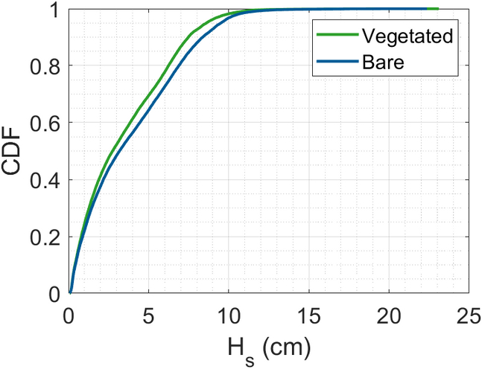
Wave Characteristics
Data analysis focuses on Apr - Mid Jun
Reference climate: Lagoon is characterized by low-energy, fetch limited wind waves
80th percentile wave height (H80) = 6.2-6.9 cm
Median avg. wave period, Tavg: 1.22 s
Sites experience similar wave forcing in the early growth period validating bare site as a viable reference
Results
Notes:
A critical check: ensure that the wave forcing was similar during our comparison periods.
The plot shows that the wave characteristics (total forcing) at both the bare and vegetated sites were similar, particularly during the early periods.
This validates the use of the bare site as a true reference for calculating attenuation.

Slide 14
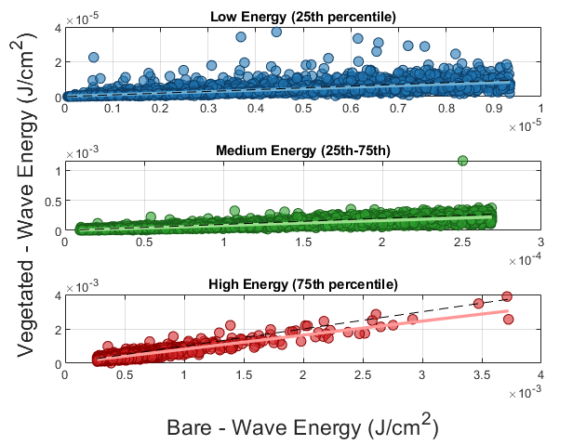
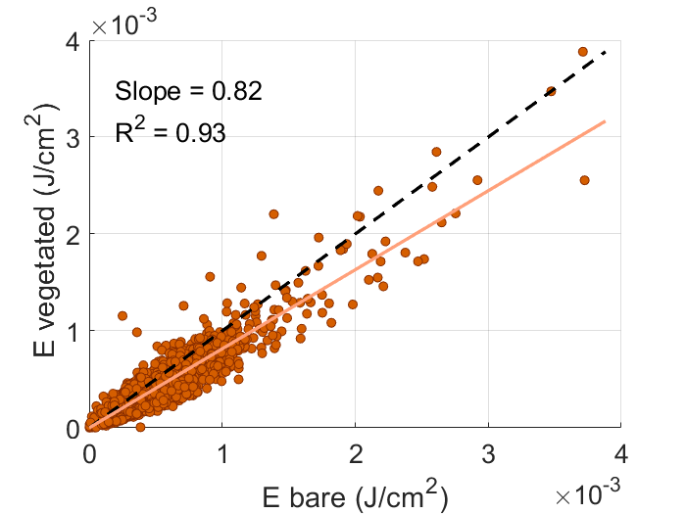
Wave Energy Attenuation
Wave energy attenuated by 18% overall
Wave energy attenuation increases with wave energy
Low E: 13.6%
Medium E: 17.2%
High E: 18.2%
Results
Notes:
Our initial observations indicate the seagrass meadow attenuates wave height by 18% overall.
Attenuation reaches 18.2% in high-energy conditions.
While this is promising, and we believe it will hold, this analysis is based on a limited dataset.
The full dataset, once processed, will validate whether this reduction holds true across different hydrodynamic conditions.

Slide 15
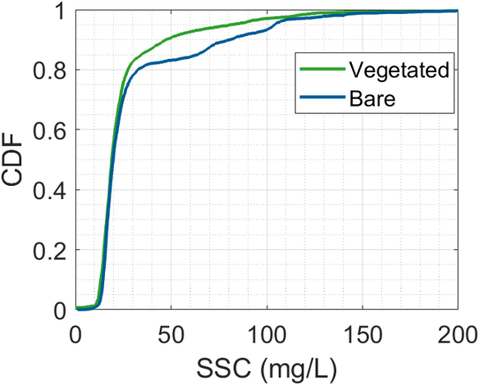
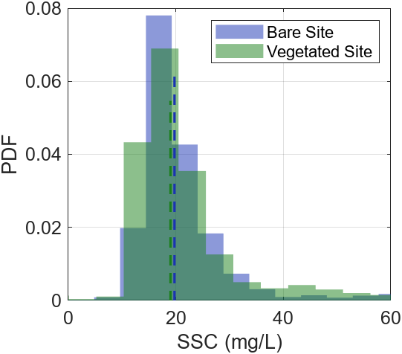
SSC Characteristics
SSC_{80, veg}: 27.43 mg/L
SSC_{80, bare} : 32.51 mg/L
median veg: 19.01 mg/L
median bare: 19.07 mg/L
Summary: The vegetated site showed a reduction in the higher end (80th percentile) SSC events compared to the bare site, suggesting mechanism reducing SSC during energetic periods
Results
Notes:
Looking at the general conditions, the median SSC was very similar between the patch (19.01 mg/L) and the bare site (19.07 mg/L).
However, if we look at the high-end events (80th percentile):
Bare site SSC: 32.51 mg/L.
Vegetated patch SSC: 27.43 mg/L.
This suggests that the seagrass reduces SSC most during more energetic events.

Slide 16
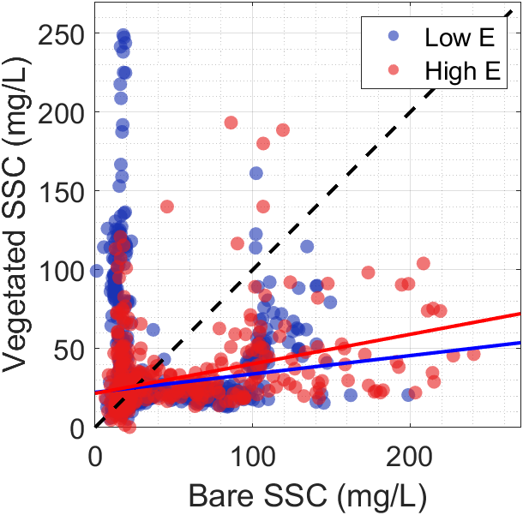
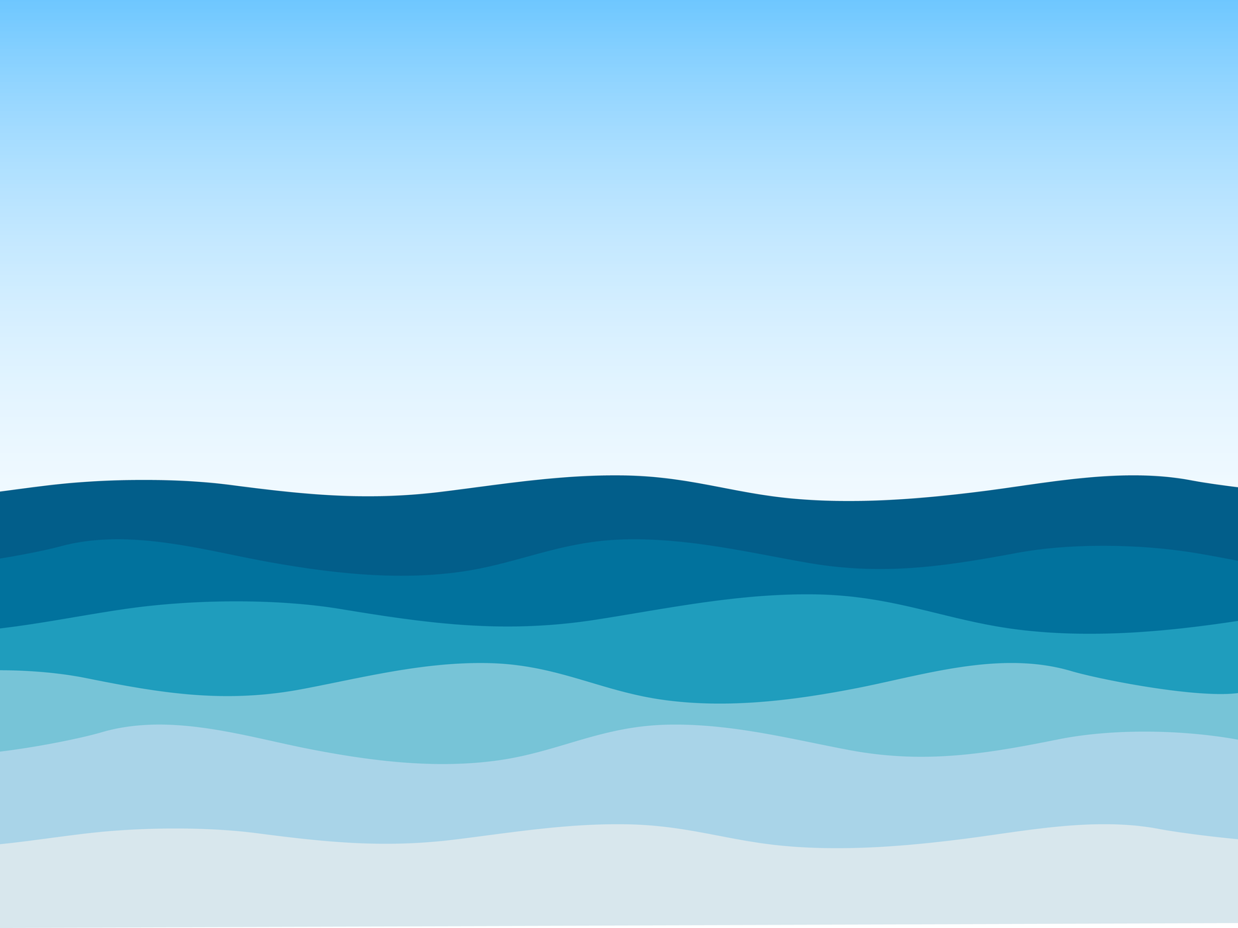

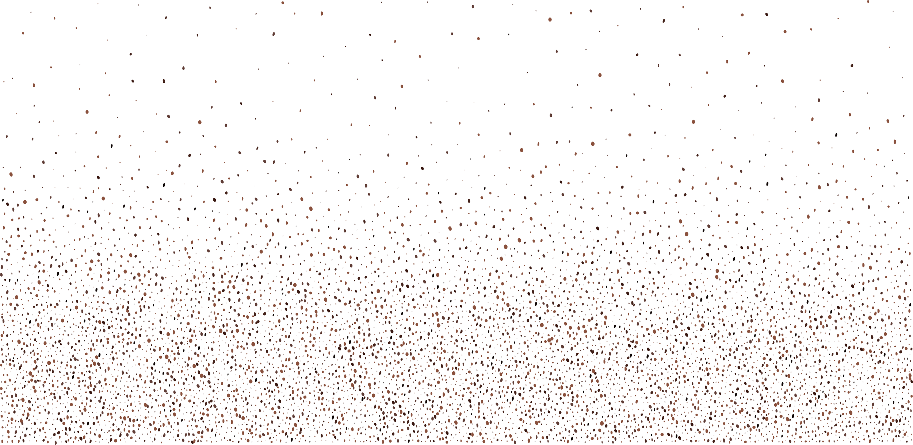
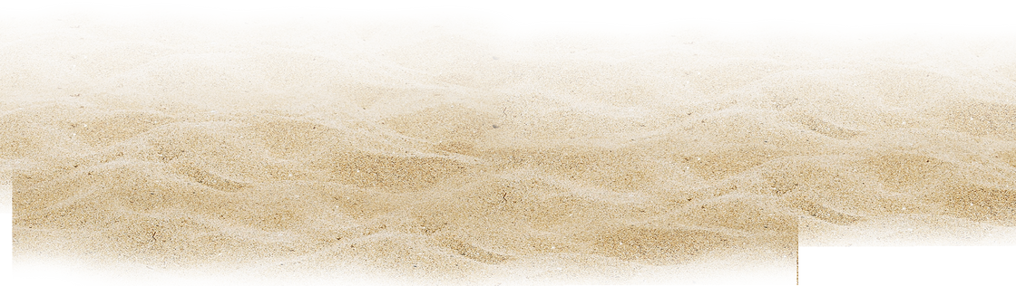

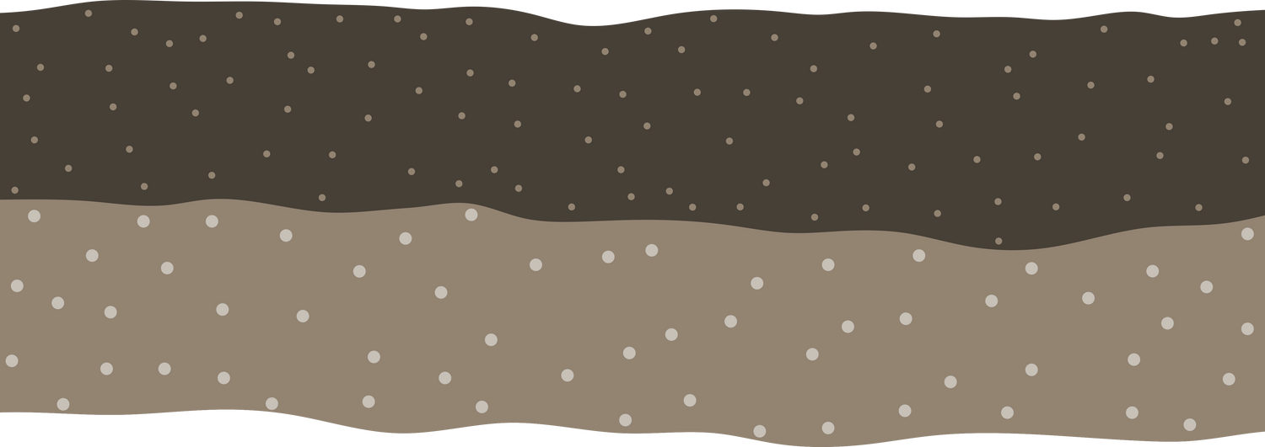
SSC and Wave Energy
Key finding: vegetated site consistently reduces SSC
Greatest SSC reduction occurs during high energy events
Results
Notes:
A key finding is that the vegetated site consistently reduces SSC.
The greatest SSC reduction occurs during high energy events.
This indicates the seagrass is trapping sediment or reducing resuspension when wave action is highest.

Slide 17
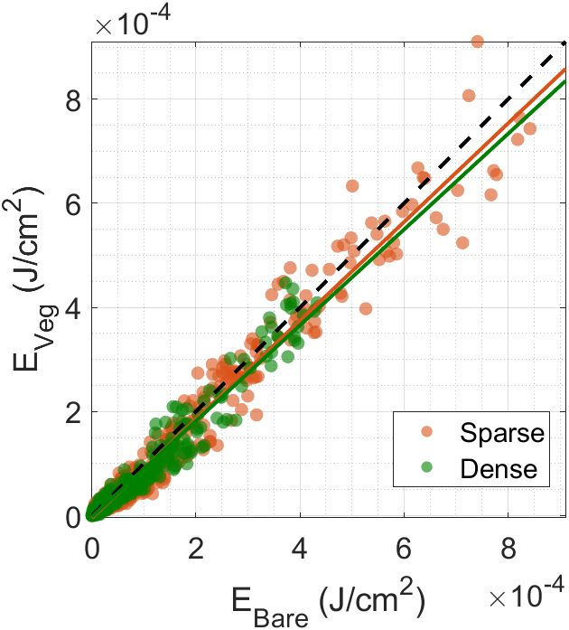
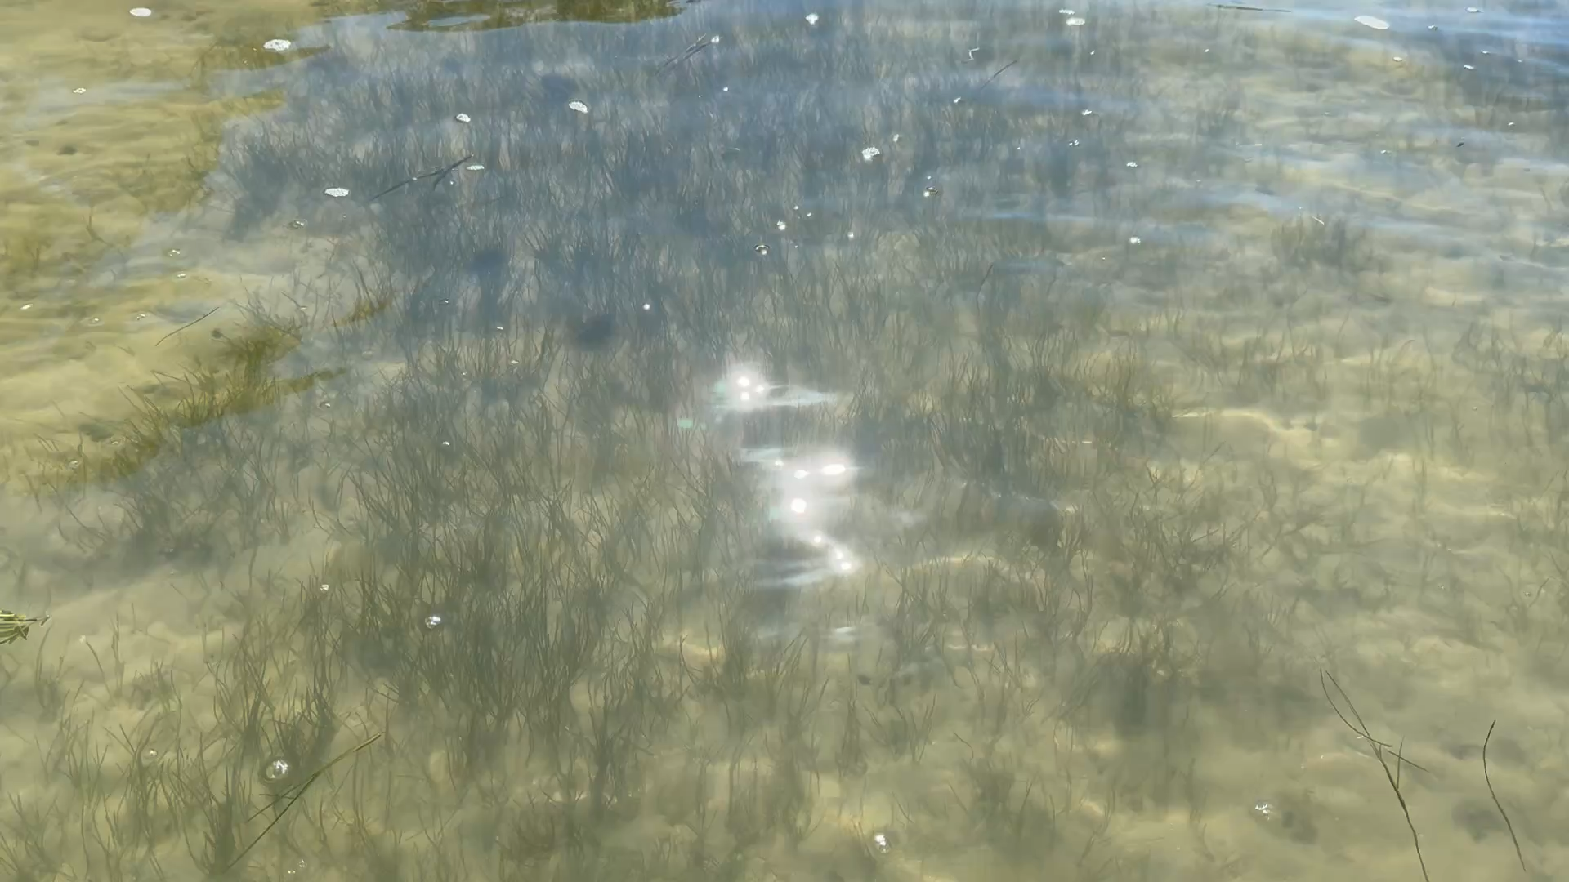
Density Impacts Energy
5.3% attenuation when sparse
8.1% attenuation when dense
Functional capacity increased by ~50% when canopy reached maturity
Results
Notes:
We split the data based on canopy density to understand how the meadow itself changes:
Sparse Period (April/May): The canopy achieved only 5.3% attenuation.
Dense Period (Matured Canopy): The average attenuation increased to 8.1%—a functional increase of over 50%.
This key finding confirms that the density of the vegetation is the primary driver of wave dissipation services and must be considered alongside the forcing energy.

Slide 18
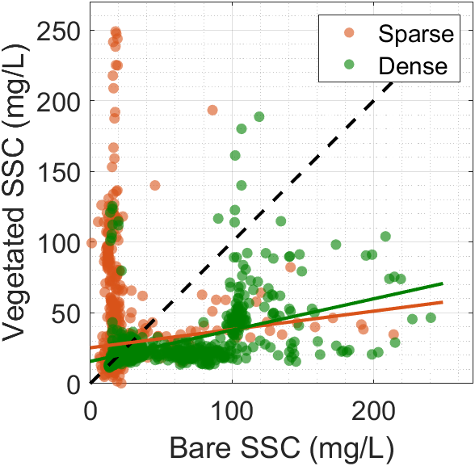
Density As a Driver
Seagrass function is dependent on canopy density
Sparse meadow led to elevated SSC resulting in a 43.3% difference percent increase compared to the bare site
Mature canopy achieved 65.2% reduction in SSC80 compared to bare site
Critical density threshold required for SSC reduction benefit
Results
Notes:
This slide shows our most significant finding: seagrass function is highly dependent on canopy density.
Sparse Canopy (Low Density):
Observed elevated SSC.
Resulted in a 43.3% increase compared to the bare site (acting as a sediment source).
Dense Canopy (Mature):
Achieved a dramatic 65.2% reduction in SSC compared to the bare site.
Conclusion: A critical density threshold is required for the seagrass to provide a net positive SSC reduction benefit.

Slide 19
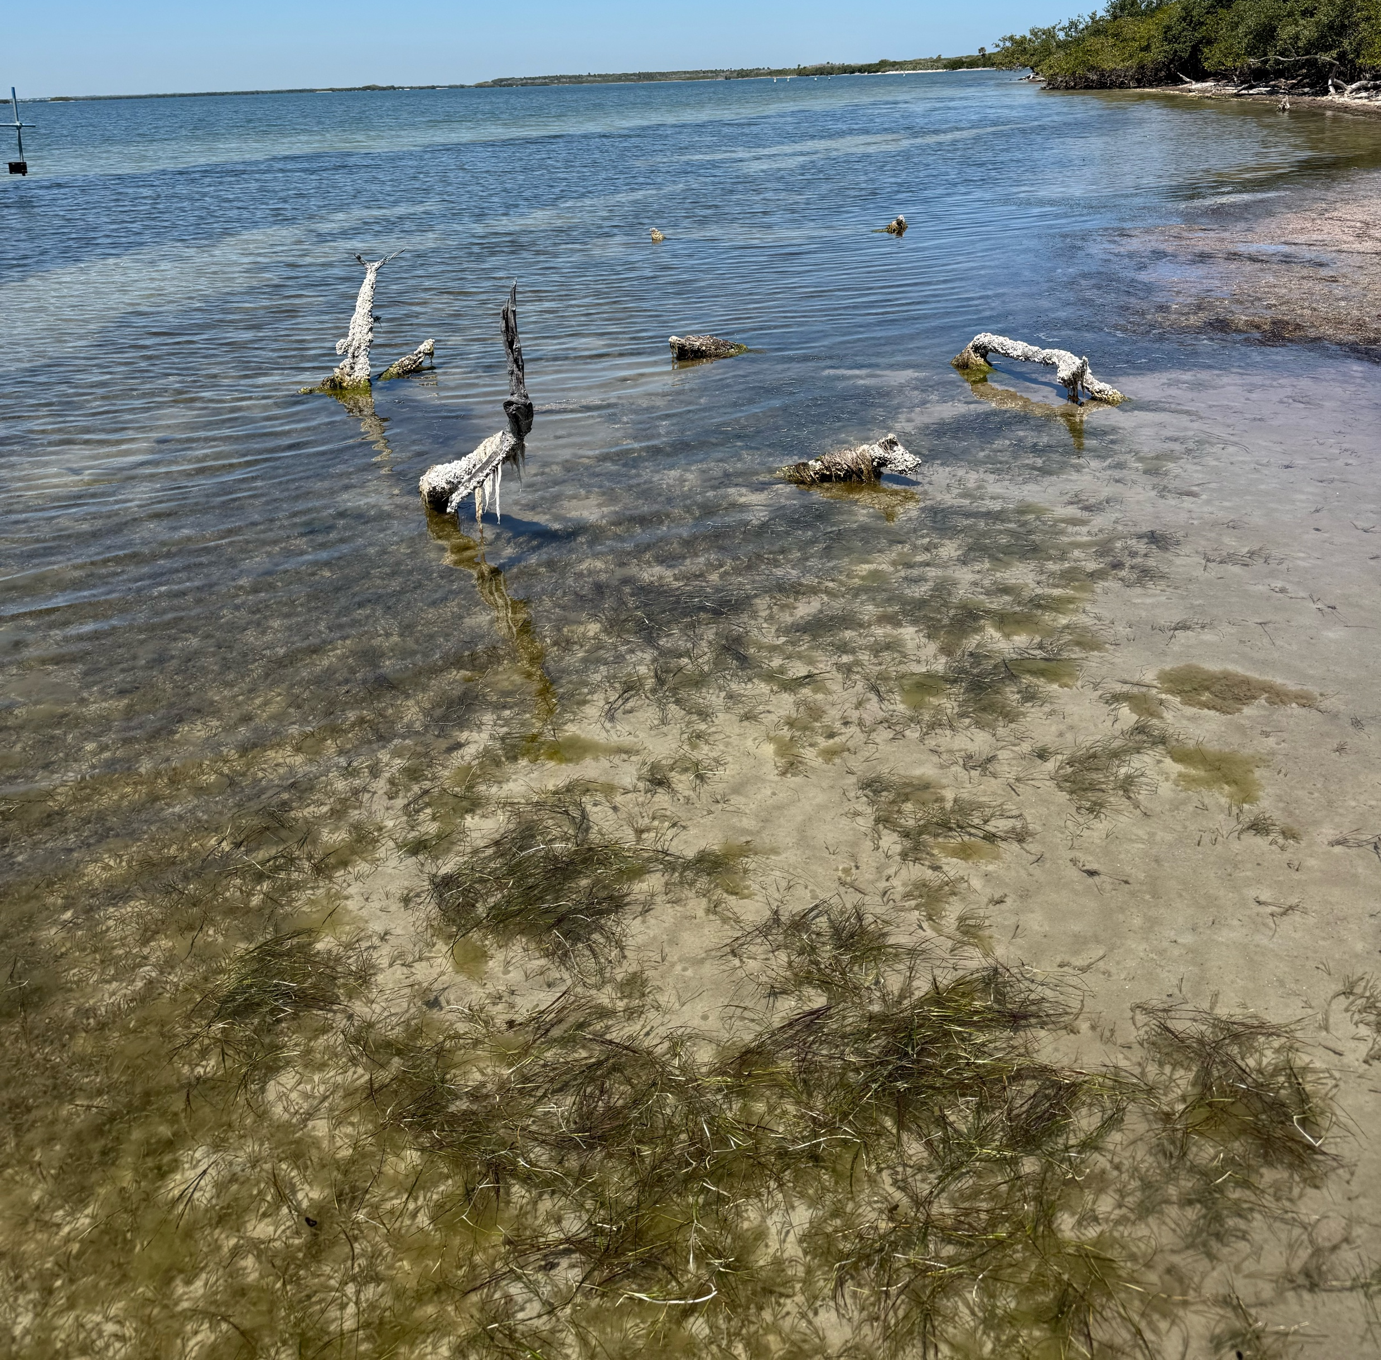
Future Implications and Work
Wave attenuation: Increased from sparse (5.3%) to dense (8.1%)
SSC: once the meadow matured a greater reduction was noticed, whereas the sparse period showed an amplification
Future work: quantify bed shear stress, define minimum functional threshold
Discussion
Notes:
Our study provides quantitative evidence that the effectiveness of seagrass meadows as a Nature-Based Feature is entirely dependent on canopy density.
For wave attenuation, function increased by 50% once the meadow achieved maturity.
For sediment stabilization, the shift was absolute: the meadow changed from being a source of sediment transport to being a highly effective SSC reducer once the density threshold was crossed.
Primary Implication for Engineering Design:
The goal is not just to plant seagrass, but to understand the conditions required to engineer a reliable and functionally effective Nature-Based Solution.
Our results demonstrate that successful NBS design must ensure a sustainable canopy density threshold is maintained.
This threshold is the crucial design criteria that must respect the dynamic and seasonal nature of seagrass growth to ensure the resulting system remains functionally protective throughout the year.
Our future work will use bed shear stress analysis to precisely quantify this minimum functional threshold needed for robust coastal protection.

Slide 20
References
Algae blooms and seagrass loss: Save the Manatee Club. Save the Manatee Club | The voice for manatees since 1981. (2025, October 28). https://savethemanatee.org/manatees/algae-blooms/
Borsje, B. W., van Wesenbeeck, B. K., Dekker, F., Paalvast, P., Bouma, T. J., van Katwijk, M. M., & de Vries, M. B. (2011). How ecological engineering can serve in coastal protection. Ecological Engineering, 37(2), 113–122. https://doi.org/10.1016/j.ecoleng.2010.11.027
Chapter 4: Sea level rise and implications for low-lying islands, coasts and communities — special report on the ocean and Cryosphere in a changing climate. (n.d.). https://www.ipcc.ch/srocc/chapter/chapter-4-sea-level-rise-and-implications-for-low-lying-islands-coasts-and-communities/
Morris, L. J., Hall, L. M., Jacoby, C. A., Chamberlain, R. H., Hanisak, M. D., Miller, J. D., & Virnstein, R. W. (2022). Seagrass in a changing estuary, the Indian River Lagoon, Florida, United States. Frontiers in Marine Science, 8. https://doi.org/10.3389/fmars.2021.789818
Seagrass. ACES. (2023, March 5). https://aces-org.co.uk/seagrass/
Temmerman, S., Meire, P., Bouma, T. J., Herman, P. M., Ysebaert, T., & De Vriend, H. J. (2013). Ecosystem-based coastal defence in the face of Global Change. Nature, 504(7478), 79–83. https://doi.org/10.1038/nature12859
Waycott, M., Duarte, C. M., Carruthers, T. J., Orth, R. J., Dennison, W. C., Olyarnik, S., Calladine, A., Fourqurean, J. W., Heck, K. L., Hughes, A. R., Kendrick, G. A., Kenworthy, W. J., Short, F. T., & Williams, S. L. (2009). Accelerating loss of seagrasses across the globe threatens coastal ecosystems. Proceedings of the National Academy of Sciences, 106(30), 12377–12381. https://doi.org/10.1073/pnas.0905620106
References
Notes:
Here is a list of references I utilized in my background slides to give me the ecological and statistical context needed for this study.
Additionally included are references from methodological studies I adapted from.

Slide 21
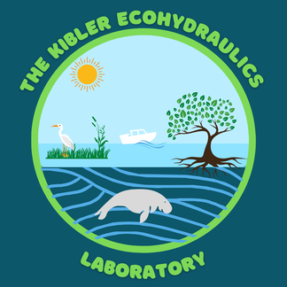

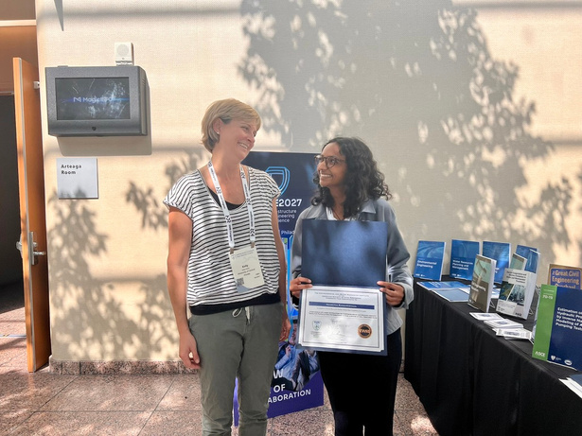
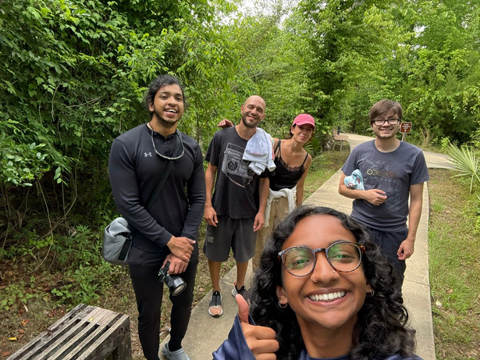


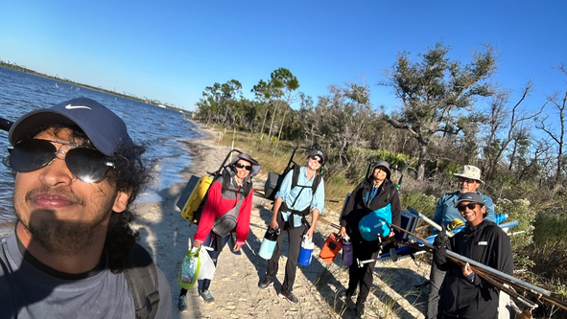
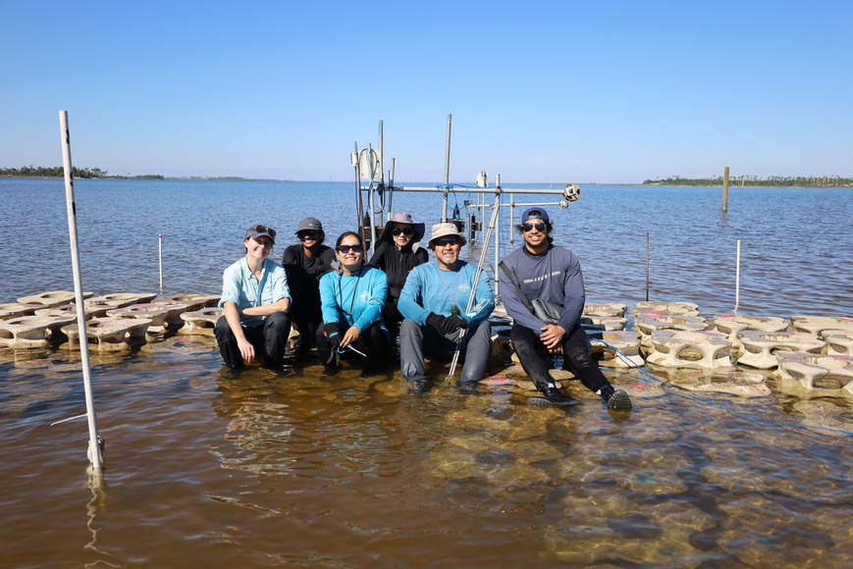
Thank You!
This work is supported by the U.S. National Science Foundation grant #1944880
The authors thank all members of the Kibler Ecohydraulics Lab for their support on this research.
Scan me!
Notes:
I’d like to extend the biggest thank you to all my lab mates that helped with the field data collection and lab data analyses, past and present mentors, and my advisor Dr. Kibler for all their support.
Research is hard but having an incredible group to cheer you on and work with makes it tenfold better.
Additionally, I would like to thank NSF for providing me the funds to pursue this study.
If you would like to connect further, I have a QR code up here with my contact information and would be excited to talk more!
I am very happy to answer any questions now if we have the time.

